Slide 1
CS@VT Spring 2021
Welcome to Graduate School.

Slide 2
What we will do today
Intro to the Department
Brief intro to the Graduate School
Classes
MEng program introduction
Programs of study (MS and PhD)
Student progress
Mechanics and Things To Do
https://gpc.cs.vt.edu/shaffer/orientationS21.html

Slide 3
COVID-19
Review https://ready.vt.edu/ if you have not already done so.
VT is going to great lengths to prepare classrooms and campus buildings.
If you are on campus, you need to be wearing a mask.
So far as we know, Spring 2021 will operate pretty much the same as Fall 2020 did. Most courses will be all or mostly online.

Slide 4
Getting Help
You cannot "just know it". Nobody expects you to.
Sources of help and information: Part of this orientation is to tell you about where to get various types of help.
In addition, it’s a good idea to find some continuing student in the CS Dept that you can ask questions of if you need to!! There are lots of VT-specific mechanical things that you need to know, that senior students can help with.
CS Grad Council in particular is a good informal resource.
https://csgrad.cs.vt.edu/

Slide 5
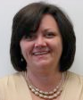
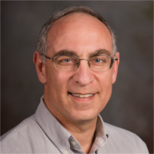
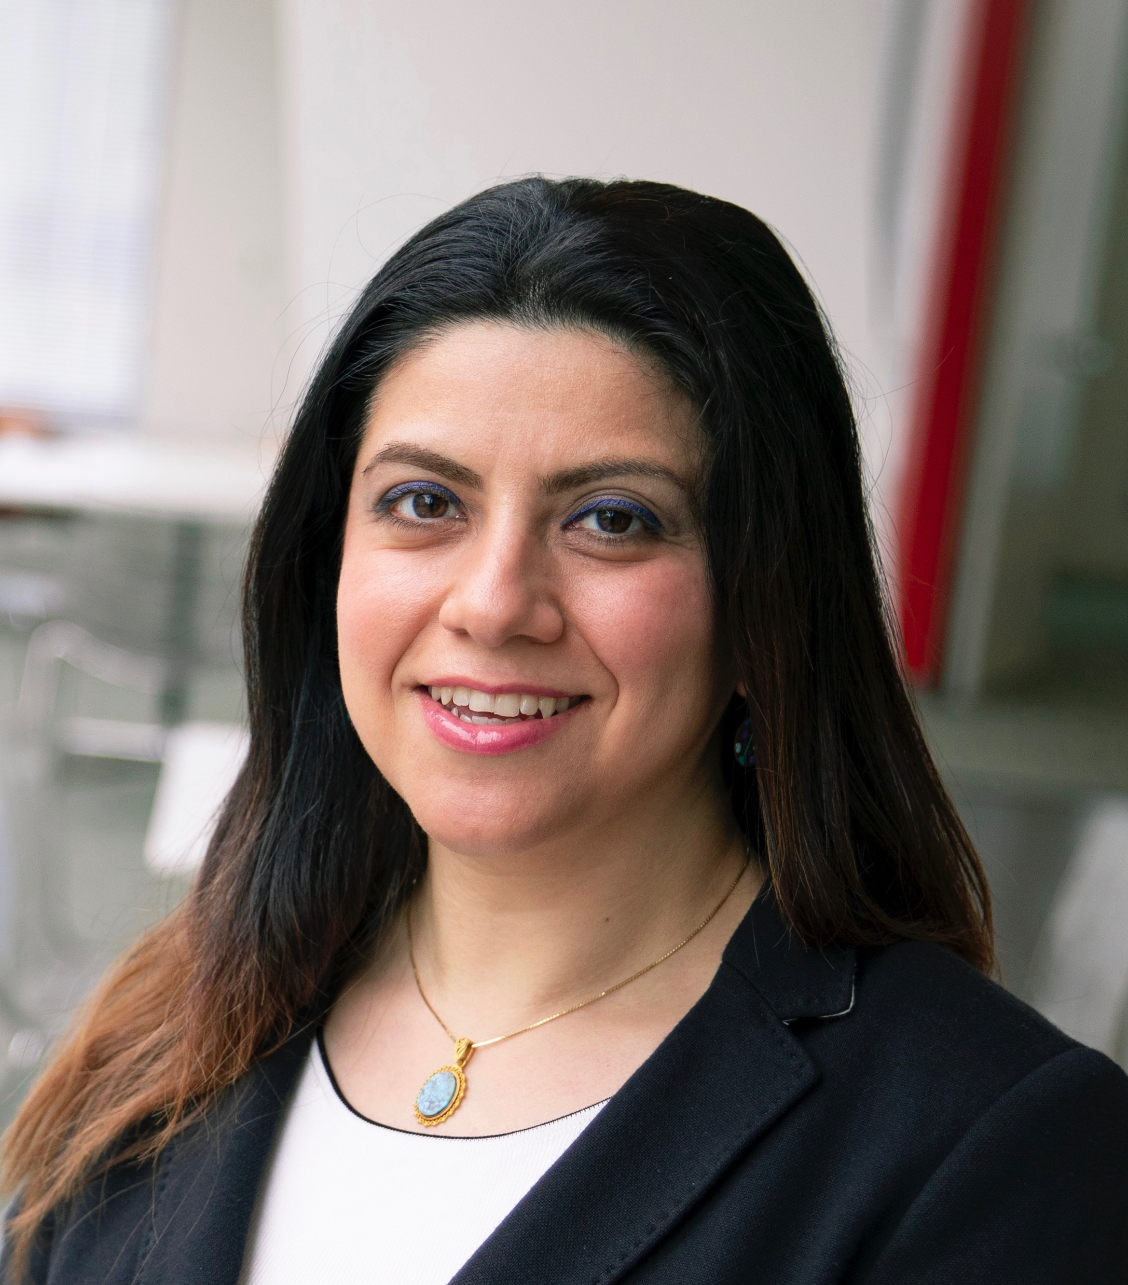
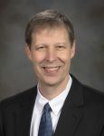
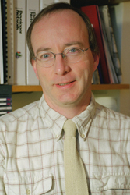
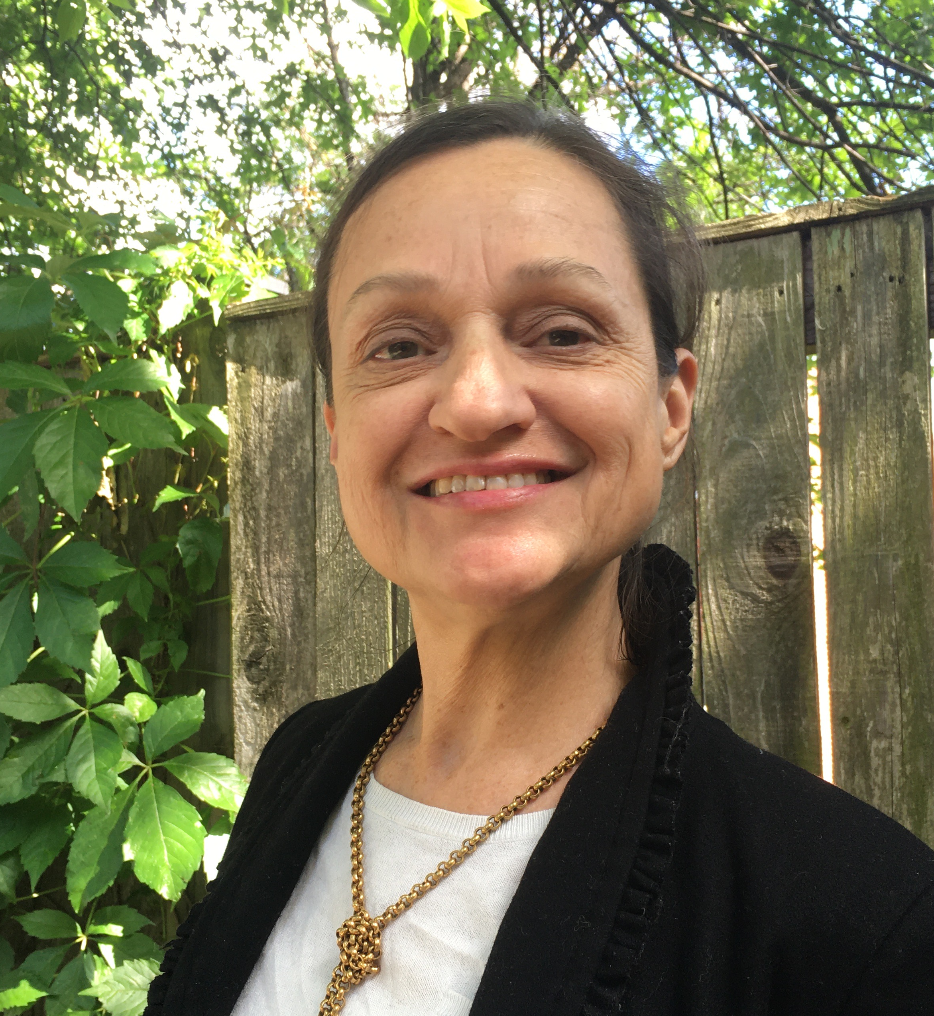
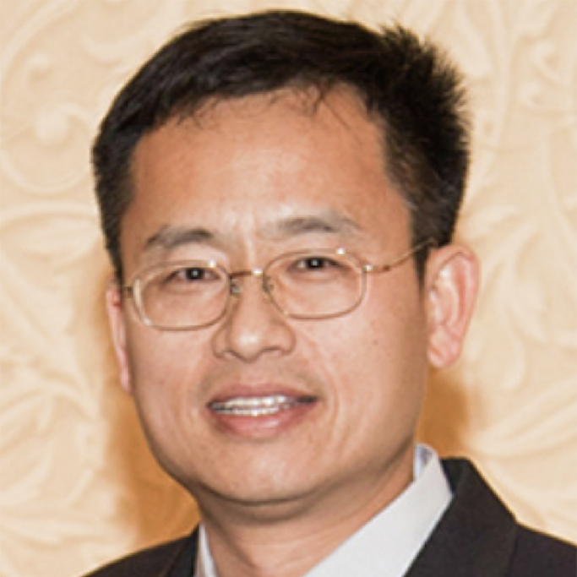
CS@VT Graduate Program People
Sharon Kinder-Potter
Dr. Shaffer
Dr. Hooshangi
Dr. Ribbens
Dwight Barnette
Dr. Shaffer
Samantha Pipkin
Department Head
Director, Academic Operations
Initial Graduate Advisor
MEng Program Director
Associate Department Head for Graduate Studies
C.T. Lu
Roxanne Paul
NCR Program Director

Slide 6
Where to find people in Blacksburg…
Knowledge Works II (KWII)
Main CS Office, Primarily HCI (downstairs) and Systems/SE (upstairs)
Dept Head (Ribbens), Assoc. Dept. Head (Edwards), Grad Coord (Kinder-Potter)
McBryde (MCB) – on campus
Mostly undergraduate facilities (but moving to Torgersen)
Classes might be there
Torgersen Hall – on campus
Assoc. Dept. Head (Shaffer)
CS Seminar Class, other CS labs, grad student offices, and centers
CS Undergraduate Learning Center (Basement floor MCB)
your TA job might be there
Moss Center for the Arts
ICAT – Institute for Creativity, Arts and Technology

Slide 7
Where to find people in NCR…
Falls Church (not quite this year but in a usual semester)
CS NCR Offices, on 3rd and 4th floor
Dr. Hooshangi & Dr. Lu / Samantha and Roxanne
All classes are held here in a normal semester
NCR Graduate School on the 4th floor
Arlington Campus
A few of our faculty have their offices there
Dr. Reddy, Dr. Ramakrishnan, Dr, Luther
No classroom- restricted access
Innovation Campus (not built until 2024 ! )
Everyone will eventually move there

Slide 8

Your new best friend…
Graduate Program Website
https://cs.vt.edu/Graduate.html

Slide 9
Main points of contact
Sharon Kinder-Potter
Dr. Shaffer
Dr. Ribbens
Dwight Barnette
YOU
Samantha Pipkin
Initial MS/PhD Advisor
Dept. Head
ribbens@vt.edu
Dr. Hooshangi
Dir. Acad. Ops.
Graduate Handbook
C.T. Lu
Teaching Assts.
Roxanne Paul
https://cs.vt.edu/Graduate.html
barnette@vt.edu
MEng Advisor
NCR Program Director
Grad. Coordinators

Slide 10
First Points of Contact
Your first point of contact for day to day requests
[MS/PhD Blacksburg] Sharon Kinder-Potter, skpotter@vt.edu
[MS/PhD NCR] Roxanne Paul, roxpaul@vt.edu
[MEng] Samantha Pipkin, samanthap@vt.edu
Academic advising
Dr. Shaffer (initial advising for MS/PhD), Dr. Hooshangi (MEng)
Start by emailing the coordinator and they can forward to others if needed

Slide 11
CS@VT by the numbers
~50 tenure track faculty (~40 Bburg, 7 NCR); 10 teaching faculty/instructors
>1500 students in CS@VT
CS Undergrads : 1200+ (Fall 2020)
CS Meng students Bburg/NCR: ~50
CS MS students Bburg/NCR: ~100 – 50 MS’s awarded annually (past 5 year average)
CS PHD students Bburg/NCR ~175 – 30 PHD’s awarded annually (past 5 year average)
Fall 2020 Grad admissions
~900 applications (total), ~100 new students
~70-80 new grad students for Spring 2021
FY20 research expenditures ~$11.7M
About $11.8M in new grants in FY20
~90 industrial partner companies in CS|Source

Slide 12
University Identification
Two flavors: PID and Hokie Passport identification number
PID is a string of characters (PUBLIC)
Will also be your PID@vt.edu email address
Example: PID=shaffer, shaffer@vt.edu
Student ID or Hokie Passport has a 9-digit code (PRIVATE)
It is a unique number that identifies your records at the university
Example: xxxx-x4354
IMPORTANT: DO NOT SEND YOURS OR ANYONE ELSE’S ID # VIA EMAIL!!!
(GTAs: Be aware of FERPA!)
Use LAST 4 DIGITS ONLY in communications

Slide 13
Email (and CS Account)
Most people will assume that you read email at PID@vt.edu
Forward email as needed!
Get your SLO (CS Department) account at https://admin.cs.vt.edu
In addition to your @vt.edu account (PID, CAS Account)
Includes web hosting access

Slide 14
Listservs
You will be automatically subscribed to some listservs; you are welcome to use them appropriately...
gradstudents@cs.vt.edu
VT CS Graduate Students on Facebook
http://www.facebook.com/groups/2444792373/
LinkedIn Group
http://www.linkedin.com/groups?gid=3691280
Slack: CS@VT

Slide 15
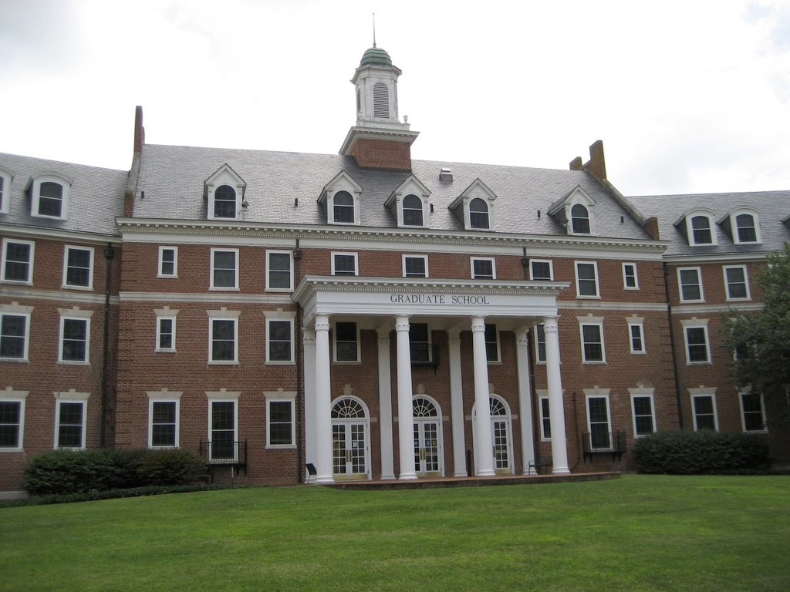
Graduate School
Graduate School
CS Department
Admissions
Policies
Minimum requirements
Award Degrees
Teaching
Advising
Supervising research
Local requirements

Slide 16
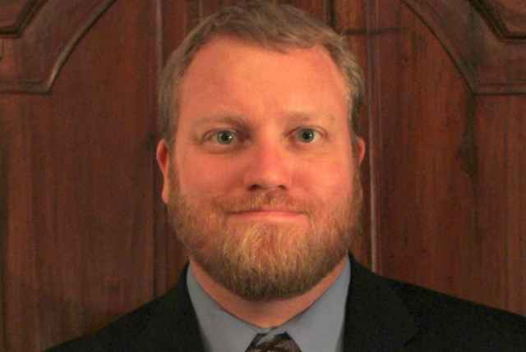
Main Points of Contact (GLC)
Cranwell International Center
for international students
Cook Counseling Center
for wellness, academic skills
Graduate Student Ombudsperson
Bryan Hanson
For a safe place to be heard (confidential)
Plenty of other administrative offices throughout the university (check the website)

Slide 17
Graduate Life Center (GLC)
http://www.graduatelifecenter.vt.edu/
Next to Squires on campus
Location of Graduate School Offices
Lots of spaces for graduate students use only
Au Bon Pain
Computer Lab, reading lounge, etc.
Offices for Graduate Student Association

Slide 18
Graduate School- NCR
Falls Church campus
Classes and spaces to study
Library in the basement (where you get your ID)

Slide 19
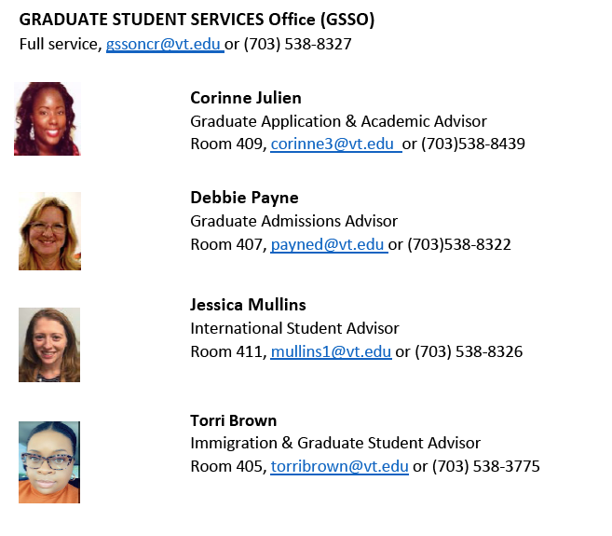
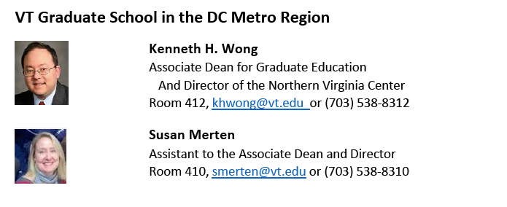
Point of contact-Graduate School: DC
Primary graduate school contact

Slide 20
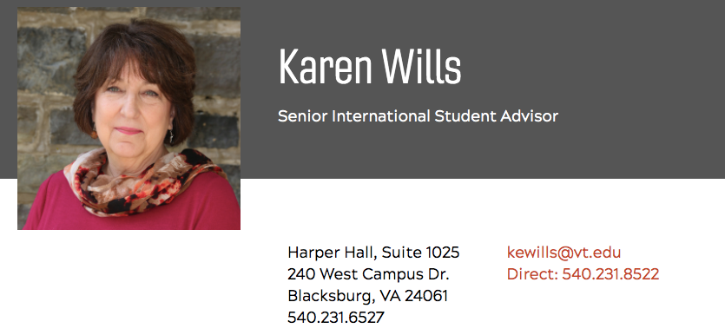
Point of contact- International students
https://international.vt.edu/
Blacksburg
Cranwell International Center (international@vt.edu)
CS-Advisor: Karen Wills kewills@vt.edu
NCR
Jessica Mullins: intlncr@vt.edu

Slide 21
Signing up for classes
Course Number vs Course Request Number (CRN)
“CS 5204” vs “91860”
CRN identifies the particular section
https://cs.vt.edu/Graduate/Courses.html - listing of courses
Timetable of Classes
http://www.registrar.vt.edu/
Not all courses on timetable are available to you
Not all classes on the course list are taught each semester
Force-Add Requests (when nothing else works): https://virginiatech.qualtrics.com/jfe/form/SV_37ALQ5iTXEibcnH

Slide 22
Special Topics Courses for Spring 2021
See: http://people.cs.vt.edu/~barnette/grad/courses/

Slide 23
Master of Engineering (MEng)
Course-only master’s degree
30 credits = 10 courses
1 ethics course
1 capstone course
3 courses in one concentration area
5 additional courses * (CS-5040 included if undergrad degree is not in CS)
No “external” requirements (seminars, projects, etc.)

Slide 24
How many courses should I take?
Full-time
>=9 hrs (Three or four courses)
Recommended number is 9 hrs if you are not sure
Part-time
<= 6 hrs (One or two courses)
International students must be full-time and take at least 9 credits during fall and spring semesters, except their final semester.

Slide 25
Typical duration
Full time
1.5 year: Spring 21 (3 courses), Summer 21 (1 courses),
Fall 21 (3 courses), Spring 22 (3 courses)
1 year: Spring 21 (4 courses), Summer 21 (2 courses),
Fall 21 (4 courses)
2 years: Spring 21 (3 courses), Fall 21 (3 courses),
Spring 22 (3 courses), Fall 22 (1 course)
Part-time
3-4 years: 1 or 2 courses per term

Slide 26
Which courses?
Follow your Plan of Study (POS)
Satisfy
Requirements (ethics, capstone, 5040)
Concentration
6 different areas
Min and max constraints
5000 level, 4000 level (You can take up to two 4xxx courses)
Cognate courses
Max 1 course outside the department
Graduate Handbook
https://cs.vt.edu/Graduate.html

Slide 27
CS 5040
Your admission letter should tell you where you stand with these requirement
Unless you were a deferral
Generally you should have been given an exemption:
If you have an undergraduate degree in CS
If you have taken multiple courses that covered advanced data structure concepts, object oriented design and substantial java programming
Took CS-3114 at VT
Otherwise you must take CS-5040 in your first/second term

Slide 28
Concentrations (MEng)
Data analytics and machine learning
Computer security
Artificial intelligence
Software engineering
Internet software development
Human-computer interaction* (only offerd at BB currently)
Can find the course area in our course catalogue at cs.vt.edu

Slide 29
Research Track: MS and PhD

Slide 30
How many courses?
Full time status
>=9 hrs; >=12 hrs (if funded on GRA or GTA)
Use padding (CS 5994/CS 7994: research credits)
MS students
≤ three 3-credit courses generally
(≤ two if you are on assistantship)
+ CS 5944: Graduate Seminar (1 credit)
+ CS 5994: MS Thesis Credits (padded)
PhD students
≤ two 3-credit courses
+ CS 5944: Graduate Seminar (1 credit)
+ CS 7994: PhD Thesis Credits (padded)
Graduate Handbook
https://cs.vt.edu/Graduate.html

Slide 31
Which courses?
Follow your Plan of Study (PoS)
Satisfy
Number of courses (MS: 7, PhD: 9)
Breadth
4 different areas
Min and max constraints
Cognate courses
NOTE: New GTAs must take GRAD5004 for 1 credit
Graduate Handbook
https://cs.vt.edu/Graduate.html

Slide 32
Sample M.S./Ph.D. Semester 1
CS 5xxx (3) [Breadth area 1]
CS 5xxx (3) [Breadth area 2]
CS 5944 (1) Graduate Seminar
[Optional if NOT on GRA/GTA: CS xxxx (3)]
[Optional: Pad with CS 5994 / CS7994]
You can take up to two 4xxx courses for credit; use to address any deficiencies.
Start talking to students and faculty throughout semester to identify potential research groups.
Graduate Handbook
https://cs.vt.edu/Graduate.html

Slide 33
Course sampling…
(see https://www.cs.vt.edu/Graduate/Courses.html)
Research Methods in CS
Algorithms and Theory
Systems
Programming Languages and Compilers
Numerical and Scientific Computing
Computer Networks
Data and Information
Software Engineering
Human-computer Interaction
User Interface Software
Intelligent Systems
Computational Biology and Bioinformatics
Computational Cell Biology
Programming Massively Parallel Hardware
Video Games
Advanced Distributed Systems
Algorithm Visualization
Software Systems Evolution
Embodied Interaction
Distributed Coordinated Behavior
Media Spaces
Genome Bioinformatics

Slide 34
Ph.D. and M.S. Programs
You are admitted to a specific degree program
Degree programs and classification
M.S. Thesis
M.S. Coursework option - “along the way for PhDs”
Ph.D.
Dissertation (only option)
Graduate Handbook
https://cs.vt.edu/Graduate.html

Slide 35
Requirements
M.S. Thesis option
30 credit hours = 7 courses (21) + research (6-9)
2 credit hours = 2 CS 5944 (seminars)
M.S. Coursework option: Only for PhDs
Ph.D.
90 credit hours = 9 courses (27) + research, etc.
2 credit hours = 2 CS 5944 (seminars)
Graduate Handbook
https://cs.vt.edu/Graduate.html

Slide 36
Typical Duration
If you are fresh out of a BS
M.S: typically 2 years
Ph.D: typically 5 years
If you already have a Masters
Ph.D: might reduce by a year

Slide 37
M.S. Thesis
Advanced coursework with guided research depth component
30 credits = 7 courses (21) + research (9)
Typical
2 + 2 + 2 + 1courses across four semesters, write thesis in 3rd and 4th semesters
Pick advisor by end of first year
Use in-between summer to focus research topic
File Plan of Study at end of 2nd semester (this Spring)
Last semester: thesis defense/final exam
Warning: Thesis pretty much has to be written (draft for advisor) by early March.

Slide 38
Ph.D.
Depth and breadth beyond B.S. and M.S.; apprenticeship to become an independent researcher or teacher
90 credit hours with at least 9*3cr (courses)
Major Milestones
Qualifying process: classes && (exam + research)
Preliminary proposal
Research defense
Final defense

Slide 39
Ph.D. Decisions
IMPORTANT: Single Most Important Decision in Grad School for Ph.D.
SELECT AN ADVISOR
Why? 3-5 years, working closely, they shape many things for you from your dissertation topic to your POS to your internships to your graduation date to your marketability upon graduation.
How? Ask around: How long do students take to graduate for certain advisors? Where do the students end up after? Are they a seasoned veteran or a sparky upstart? Are they very active or semi-retired from research?
Consider a trial period with a group. If it works, fine. If not, keep looking. Join reading groups or take a class from someone you are leaning towards.
You can change advisors if you want. BUT… Changing advisors is costly in time and may limit your options later.
[Don’t worry if you change advisor in 1st year of PhD or so]

Slide 40
PhDs: Consider these steps…
Semester 1:
Visit research groups, get to know advisors and their areas. Start doing this ASAP.
Semester 2:
Select and start working with advisor
Toward end of Spring 2022:
Work with advisor to set milestones, file Plan of Study (PoS)
January 2022: Take PhD Qualifier exam

Slide 41
Do I need M.S. (for Ph.D.)?
No. But, …
Ph.D. requirements ⊃ M.S. requirements
So can get M.S. free, “on the way”
Some advisors will suggest you to do an M.S. thesis before embarking on a Ph.D.
If you already have taken graduate courses elsewhere
Can transfer up to 3 courses (9 credits) toward an M.S.
Can transfer up to 4 courses (12 credits) toward a Ph.D.

Slide 42
What can I transfer?
Specific courses (e.g., CS 5804)
IF equivalent to an existing CS course
IF equivalent to an existing non-CS course
If it “sort of” looks like a grad course that we might offer if we had the right faculty in that area (general electives)

Slide 43
Who decides on transfers?
When transferring as specific courses
Any faculty member who teaches that course here on a periodic basis
When transferring as generic courses
Any faculty member who has some expertise in that area
What do faculty members look for?
Web sites, homeworks, textbook, whatever you can lay your hands on
The more the better here.

Slide 44
When to transfer?
Earlier is better…but,
Not right now! Not next week either!
Give the faculty a chance to get the semester rolling.
Consider that this will go on your Plan of Study and you won’t file that until second or third semester

Slide 45
Student Progress
12 credits/semester (if full time)
More than 2 courses will stop you from making research progress, so MS/PhD students should not do that. Use research hours as padding.
Students on assistantship can take at most 2 courses
Maintain overall GPA of 3.0
File plan of study (PoS) before end of 2nd semester (MS) or 3rd semester (PhD)
You will update later as you change your plans
File Student Activity Report every year and receive positive evaluation

Slide 46
Green Thursday
Student Activity Report (SARs) = Annual evaluation
Due in March of every year
You provide info about your progress (publications, courses, other activities)
Your advisor makes an assessment of your progress (very good, satisfactory, unsatisfactory, lack of minimal progress)
Faculty meets on Green Thursday (typically early May)
Results are used to determine status in program
Students not making progress may suffer consequences
E.g., loss of TA or RA funding, probation, expulsion from program.

Slide 47
Ethics
Great research is built upon truth and moral principals (ethics).
Violating ethics in research can:
Embarrass you, your advisor, your department, your university
In severe cases, M.S. and Ph.D. degrees are withdrawn years after completion.
Compliance with the Graduate Honor Code requires that all graduate students exercise honesty and ethical behavior in all their academic pursuits here at Virginia Tech, whether these undertakings pertain to study, course work, research, extension, or teaching
See more at: https://graduateschool.vt.edu

Slide 48
Ethics/Diversity Training Requirements
Grad School requires that all students receive instruction in Ethics, and also in Diversity and Inclusion
These requirements are satisfied by taking EITHER
CS5014 Research Methods
CS5024 Ethics and Professionalism in CS

Slide 49
Funding Opportunities (GTA/GRA)
Graduate Teaching Assistantships (GTA) are offered by the Department
PhD students and research-active MS students are given priority.
See https://hosting.cs.vt.edu/gta/newCSGrad.html
Graduate Research Assistantships (GRA)
Offered by individual faculty members
The sources of funding vary
Best sources: Independent fellowships from external source (NSF, NIH, IBM, LLNL, etc)
Good sources: Basic research (e.g., NSF, NIH), usually tightly aligned to thesis
Other sources: Government or corporate contract, not always tightly aligned
Assistantships from other departments: watch your email

Slide 50
Other available Services
Travel Funding
Apply for funding for conferences
Managed by the CS Grad Council
Social
Keep an eye out for social events, grad council setup
Graduate student assembly
Get to know your fellow students and their research
Relax and have fun, Free food

Slide 51

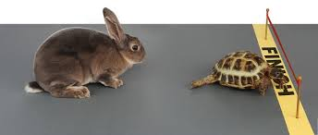
Quality of Life

Slide 52
YOUR TODO LIST:
Tonight: Get your cs.vt.edu account:
https://admin.cs.vt.edu
Tonight: Email forwarding of <PID>@vt.edu to wherever you routinely read email
Begin memorizing the grad program rules
https://cs.vt.edu/Graduate.html

